Slide 1
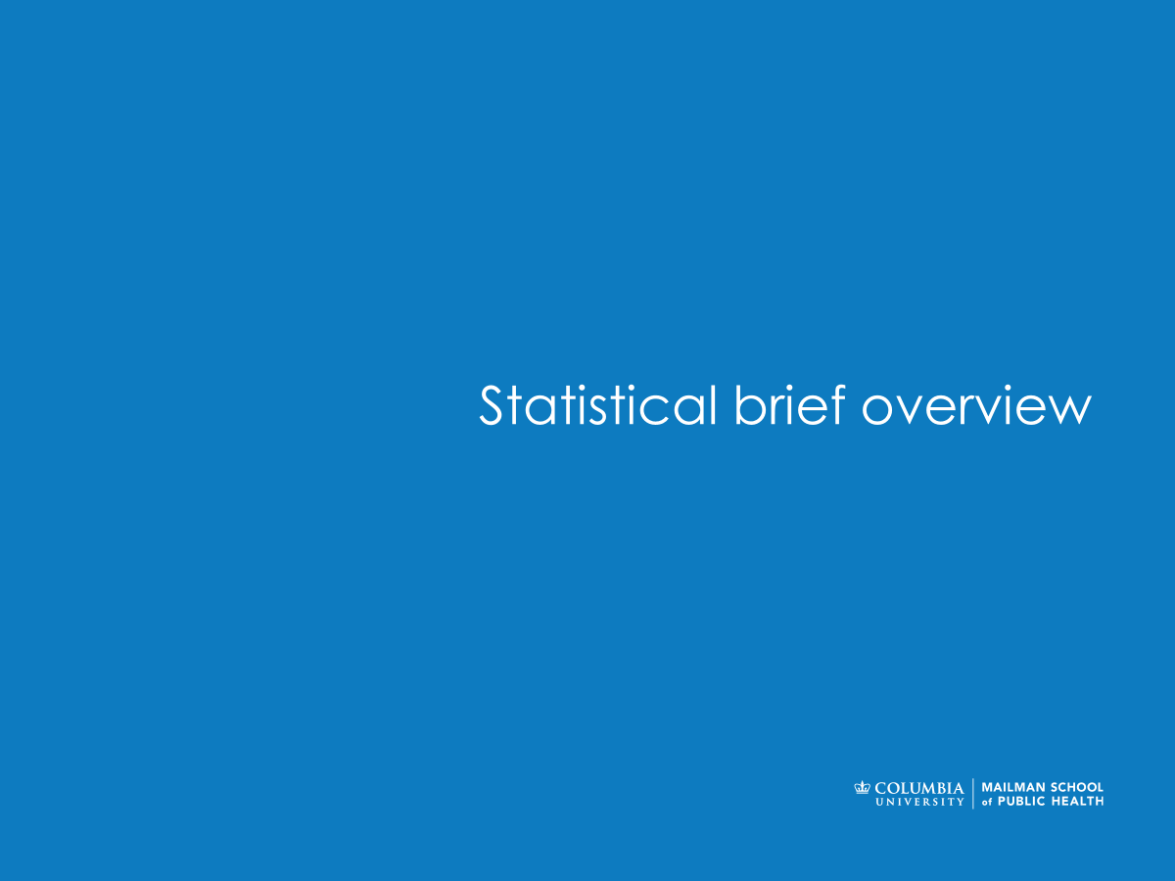

Computing in Context: Fall 2024
Lecture 2 | Data in Practice: the 80:20 rule
Statistical brief overview
Dr Sarah Ashcroft-Jones | Mailman School of Public Health

Slide 2
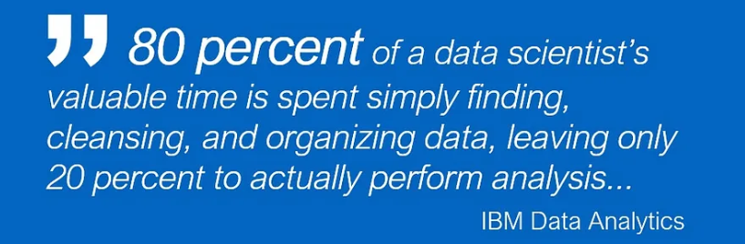

Slide 3
Cleaning Data
It’s all relative!

Slide 4
“Structured” vs. “Clean” Data
From last lecture: “Less than 15 percent of health data in EHRs are entered in structured data fields.” (Roski et al., 2014)
Even when data is “structured,” this doesn’t mean it’s “clean”
“clean”: when data is structured, edited, and/or formatted such that the desired use/analysis can be performed on it without further preparation

Slide 5
Reliability and Replicability in Data Cleaning
Reliable – error free and accurate, you can rely on it
Replicable – recreate the “clean” data again given the raw data
We want both

Slide 6
Reliability and Replicability in Data Cleaning
Code allows you to automate repetitive tasks and while reducing errors that emerge during manual edits.
GUI-based alternatives (like Excel) don’t offer the flexibility, transparency, reliability, and replicability that code does
Code tells you exactly how a piece of data was transformed and executing it will give you the same results every time.
Notes:
This is why your project will be in end-to-end python

Slide 7
Unnecessary Variables in Data
Quick note:
Often, an analysis only requires a handful of variables to conduct.
When assembling your data for analysis, feel free to drop unnecessary variables along the way if you find it helpful.
If your data “big,” this will free up memory on your computer.

Slide 8
“Clean” is a Relative Term
“clean”: when data is structured, edited, and/or formatted such that the desired use/analysis can be performed on it without further preparation
“clean” is relative: you may find that a dataset might be clean for the purposes of one type of analysis, but not for another

Slide 9
Street Addresses Example
person_id | home_address
1 | 722 w 168th st 10032
2 | 722 w 168th ave, new york 10032
3 | 722 W 168th street, new York, new york 10032
4 | 722 west 168th, new York, new york 10032
5 | 722 West 168th St, New York, New York 10032
Desired Format: 722 West 168th St, New York, NY 10032
Suppose that a hospital collects home address information for their patients. The hospital wants to adopt a standardized address format to reduce the rate of undelivered mail.
Notes:
This is a data cleaning task: You can all imagine some of the code involved in programmatically (using capitalize() and replace() string methods, for instance). Once all of the data fits into the desired format, this address field would be “clean.”

Slide 10
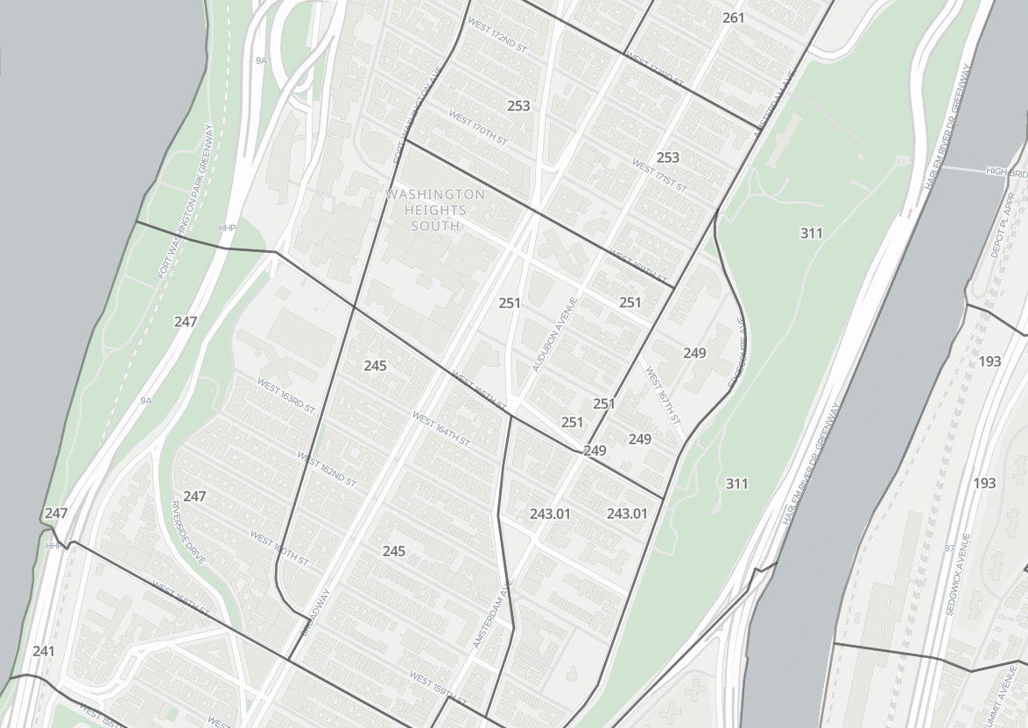
Street Addresses Example
Now suppose researchers wanted to use the same address field to identify the Census Tract for each address, to determine SES of the patient population.
The street address would not be useful. It must instead be “geocoded” (assigned latitude and longitude coordinates).
Google Geocoding API

Slide 11
Conclusion: the 80/20 Rule
Given the wide variety of uses for any data point, data preparation/cleaning important part of data science.
The “80/20 Rule” [one of many]: data scientists generally spend about 80% of their time cleaning data, and only about 20% of their time analyzing it
Obviously, this can vary tremendously by setting/role

Slide 12
Data Merging
Levels of analysis and data merges

Slide 13
Level of Analysis
Before you begin preparing dataset(s) for analysis, you must determine the level of analysis of the study.
What is the level of analysis? Envision what your final (clean) DataFrame will look like – what do the rows represent?
Note: This may differ from the initial unit(s) of observation (rows) in the various data sources that you’ll draw upon your analysis. You may need to restructure this raw data accordingly.

Slide 14
Level of Analysis
Time
Collect baseline characteristics from data generated before RCT:
“Who are these patients?”
Collect outcome measures from data generated after RCT:
“What happened to them post-trial?”
Treatment Administered
Example: Imagine that you are extracting EHR data from a hospital database relating to patients that took part in an RCT. You want to collect baselines (1 year pre-trial) and outcomes (1 year post-trial) to assess the efficacy of treatment in the RCT. E.g.
Results from lab tests
Procedures performed
Diagnoses

Slide 15
Level of Analysis
Notes:
Think about your own patient portal – demographics (level = you) versus lab results (level = test)

Slide 16
Level of Analysis
Data in EHR systems like a lot of “big data,” are stored in relational databases. Each category of data will exist in its own table(s), with unique “keys” to link them to specific patients.
The unit of observation in each table can vary. E.g., each row of the lab results table relates to an individual lab test result, each row of the procedures table relates to an individual procedure performed. Each patient may have all, some, or none of these.
Your goal is to analyze the impact of the RCT on patients (your level of analysis), so you will have to summarize or collapse this information to the level of the individual patient!

Slide 17
Level of Analysis
patient_id | lab_id | date | lab_value
1 | 123836 | 1/12/2018 | 0.512
1 | 211687 | 4/26/2018 | 300
1 | 135818 | 9/02/2018 | 1.24
3 | 123836 | 3/12/2018 | 51
3 | 365581 | 5/26/2018 | 987
4 | 981048 | 7/02/2018 | 1547
5 | 873871 | 8/15/2018 | 62
Units of observation (labs/procedures) don’t always match to your level of analysis (patients)!
patient_id | DOB | sex | group
1 | 09/06/84 | M | Treatment
2 | 07/05/85 | F | Control
3 | 06/27/57 | F | Treatment
4 | 01/28/87 | M | Control
5 | 10/30/16 | M | Control
labs
patient_id | proc_id | date | proc_code
1 | 5181 | 1/12/2018 | 0.512
2 | 2116 | 4/26/2018 | 300
4 | 5581 | 9/02/2018 | 1.24
4 | 1238 | 3/12/2018 | 51
5 | 5581 | 5/26/2018 | 987
5 | 1048 | 7/02/2018 | 1547
5 | 8871 | 8/15/2018 | 62
procedures

Slide 18
Merging data
labs_df
patient_df
patient_id | lab_id | date | lab_value
1 | 123836 | 1/12/2018 | 0.512
1 | 211687 | 4/26/2018 | 300
1 | 135818 | 9/02/2018 | 1.24
3 | 123836 | 3/12/2018 | 51
3 | 365581 | 5/26/2018 | 987
4 | 981048 | 7/02/2018 | 1547
7 | 873871 | 8/15/2018 | 62
patient_id | DOB | sex | group
1 | 09/06/84 | M | Treatment
2 | 07/05/85 | F | Control
3 | 06/27/57 | F | Treatment
4 | 01/28/87 | M | Control
5 | 10/30/16 | M | Control
Example: you want to combine your patient and labs DFs, but there some patients that appear only in one and not the other. Moreover, some patients have multiple labs. How can this data be merged?

Slide 19
Merging Data
4 types of merges between two DataFrames, (one “left” and one “right”).
E.g., ‘patient_id’ is the key that you would use to merge these tables:
Left Joins: “Use only keys from the left DF”
– only keeps observations from right DF if keys exist in left DF
Right Joins: “Use only keys from the right DF”
– only keeps observations from left DF if keys exist in right DF
Inner Joins [default]: “Use only keys common to both DFs”
– only keeps observations with keys present in both DFs
Outer Joins: “Use all keys”
– keeps all observations from both DFs

Slide 20
Left Joins
Left Joins: “Use only keys from the left DF”
– only keeps obs from right DF if keys exist in left DF
left_joined_df = patient_df.merge(labs_df, on = 'patient_id', how = 'left')
labs_df
left_joined_df
patient_df
patient_id | lab_id | date | lab_value
1 | 123836 | 1/12/2018 | 0.512
1 | 211687 | 4/26/2018 | 300
1 | 135818 | 9/02/2018 | 1.24
3 | 123836 | 3/12/2018 | 51
3 | 365581 | 5/26/2018 | 987
4 | 981048 | 7/02/2018 | 1547
7 | 873871 | 8/15/2018 | 62
patient_id | DOB | sex | group | lab_id | date | lab_value
1 | 9/6/1984 | M | Treatment | 123836 | 1/12/2018 | 0.512
1 | 9/6/1984 | M | Treatment | 211687 | 4/26/2018 | 300
1 | 9/6/1984 | M | Treatment | 135818 | 9/2/2018 | 1.24
2 | 7/5/1985 | F | Control | NaN | NaN | NaN
3 | 6/27/1957 | F | Treatment | 123836 | 3/12/2018 | 51
3 | 6/27/1957 | F | Treatment | 365581 | 5/26/2018 | 987
4 | 1/28/1987 | M | Control | 981048 | 7/2/2018 | 1547
5 | 10/30/2016 | M | Control | NaN | NaN | NaN
patient_id | DOB | sex | group
1 | 09/06/84 | M | Treatment
2 | 07/05/85 | F | Control
3 | 06/27/57 | F | Treatment
4 | 01/28/87 | M | Control
5 | 10/30/16 | M | Control

Slide 21
Right Joins
Right Joins: “Use only keys from the right DF”
– only keeps obs from left DF if keys exist in right DF
right_joined_df = patient_df.merge(labs_df, on = 'patient_id', how = 'right')
labs_df
right_joined_df
patient_df
patient_id | lab_id | date | lab_value
1 | 123836 | 1/12/2018 | 0.512
1 | 211687 | 4/26/2018 | 300
1 | 135818 | 9/02/2018 | 1.24
3 | 123836 | 3/12/2018 | 51
3 | 365581 | 5/26/2018 | 987
4 | 981048 | 7/02/2018 | 1547
7 | 873871 | 8/15/2018 | 62
patient_id | DOB | sex | group | lab_id | date | lab_value
1 | 9/6/1984 | M | Treatment | 123836 | 1/12/2018 | 0.512
1 | 9/6/1984 | M | Treatment | 211687 | 4/26/2018 | 300
1 | 9/6/1984 | M | Treatment | 135818 | 9/2/2018 | 1.24
3 | 6/27/1957 | F | Treatment | 123836 | 3/12/2018 | 51
3 | 6/27/1957 | F | Treatment | 365581 | 5/26/2018 | 987
4 | 1/28/1987 | M | Control | 981048 | 7/2/2018 | 1547
7 | NaN | NaN | NaN | 873871 | 8/15/2018 | 62
patient_id | DOB | sex | group
1 | 09/06/84 | M | Treatment
2 | 07/05/85 | F | Control
3 | 06/27/57 | F | Treatment
4 | 01/28/87 | M | Control
5 | 10/30/16 | M | Control

Slide 22
Inner Joins
Inner Joins: “Use only keys common to both DFs”
– only keeps obs with keys present in both DFs
inner_joined_df = patient_df.merge(labs_df, on = 'patient_id', how = 'inner')
labs_df
inner_joined_df
patient_df
patient_id | lab_id | date | lab_value
1 | 123836 | 1/12/2018 | 0.512
1 | 211687 | 4/26/2018 | 300
1 | 135818 | 9/02/2018 | 1.24
3 | 123836 | 3/12/2018 | 51
3 | 365581 | 5/26/2018 | 987
4 | 981048 | 7/02/2018 | 1547
7 | 873871 | 8/15/2018 | 62
patient_id | DOB | sex | group | lab_id | date | lab_value
1 | 9/6/1984 | M | Treatment | 123836 | 1/12/2018 | 0.512
1 | 9/6/1984 | M | Treatment | 211687 | 4/26/2018 | 300
1 | 9/6/1984 | M | Treatment | 135818 | 9/2/2018 | 1.24
3 | 6/27/1957 | F | Treatment | 123836 | 3/12/2018 | 51
3 | 6/27/1957 | F | Treatment | 365581 | 5/26/2018 | 987
4 | 1/28/1987 | M | Control | 981048 | 7/2/2018 | 1547
patient_id | DOB | sex | group
1 | 09/06/84 | M | Treatment
2 | 07/05/85 | F | Control
3 | 06/27/57 | F | Treatment
4 | 01/28/87 | M | Control
5 | 10/30/16 | M | Control

Slide 23
Outer Joins
Outer Joins: “Use all keys” – keeps all obs from both DFs
outer_joined_df = patient_df.merge(labs_df, on = 'patient_id', how = ‘outer')
labs_df
outer_joined_df
patient_df
patient_id | lab_id | date | lab_value
1 | 123836 | 1/12/2018 | 0.512
1 | 211687 | 4/26/2018 | 300
1 | 135818 | 9/02/2018 | 1.24
3 | 123836 | 3/12/2018 | 51
3 | 365581 | 5/26/2018 | 987
4 | 981048 | 7/02/2018 | 1547
7 | 873871 | 8/15/2018 | 62
patient_id | DOB | sex | group | lab_id | date | lab_value
1 | 9/6/1984 | M | Treatment | 123836 | 1/12/2018 | 0.512
1 | 9/6/1984 | M | Treatment | 211687 | 4/26/2018 | 300
1 | 9/6/1984 | M | Treatment | 135818 | 9/2/2018 | 1.24
2 | 7/5/1985 | F | Control
3 | 6/27/1957 | F | Treatment | 123836 | 3/12/2018 | 51
3 | 6/27/1957 | F | Treatment | 365581 | 5/26/2018 | 987
4 | 1/28/1987 | M | Control | 981048 | 7/2/2018 | 1547
5 | 10/30/2016 | M | Control | NaN | NaN | NaN
7 | NaN | NaN | NaN | 873871 | 8/15/2018 | 62
patient_id | DOB | sex | group
1 | 09/06/84 | M | Treatment
2 | 07/05/85 | F | Control
3 | 06/27/57 | F | Treatment
4 | 01/28/87 | M | Control
5 | 10/30/16 | M | Control

Slide 24
Merging Data: 1-to-1 or 1-to-Multiple?
Merging DFs on a 1-to-1 basis –one row in a table corresponds to only one row in another DF – is straightforward.
If rows in one DF correspond to multiple rows in another DF, you may need to collapse these rows to your level of analysis.
We will use Pandas DataFrame tools like group.by(), melt(), pivot(), and others to solve this.

Slide 25
Missing Data & Outliers
Why, what, when?

Slide 26
Missing Data
It is very common to have missing values in your data – that is, for some rows (observations), one or more variables (columns) will be “empty”
In Pandas, this is represented by cells containing NaN or None*
Why might you have missing data?
What should you do about it?
The answer to 2) may depend on 1).
The use of NaN is preferred in Pandas – for consistency, try to avoid using None.
Notes:
Switch to Spyder to view

Slide 27
Why is this Data Missing?
Some typical reasons why data is missing:
User forgot to fill in a field
Data was lost while transferring manually from a legacy database, or from a non-digital source
There was a programming error
Users chose not to fill out a field
Always ask yourself: is the missing-ness random? If not, and it’s correlated with outcomes of interest, consider how this may change your analysis.

Slide 28
Why is this Data Missing?
Example: Suppose that a health clinic asks its patients to fill out a short questionnaire at the beginning of each visit.
“Since your last visit, have you consumed any drugs recreationally?”
1% responded “Yes,” 90% responded “No,”9% left their answer blank.
Is it reasonable to assume that these missing values are unrelated to patients’ drug use?
Probably not.

Slide 29
Some Common Missing Data Solutions
Drop the observations with any missing values from the dataset
Exclude observations with a missing values on a column-by-column basis:
Impute missing values
Notes:
But if many observations have at least some missing values (common in datasets with many columns), this will throw away a lot of your data
E.g., you include them in your estimate of the mean age in the dataset, but remove when estimating the proportion of females
3. Using other information in the data, estimate what the “true” value is likely to be, and replace the missing value with this estimate
Be careful estimating statistical significance with imputation

Slide 30
Sensitivity Analysis – Never a Bad Idea
A sensitivity analysis helps to see whether your conclusions change under various assumptions.
How? See what happens to your estimates when you replace missing values with a variety of different values.
Estimating the mean age of patients who visit a health clinic, but some of the values are missing? What happens to your estimate of this mean when you replace missing values with the 1st %-tile of age? The 99th%-tile? The 75th? The 25th?

Slide 31
“Standard” vs “Non-Standard” Missing Values
So far we’ve been implicitly discussing missing data as though Pandas functions will always recognize missing values, and label them appropriately – standard missing values.
However, it’s often the case that a dataset has missing values that are clear to the human eye, but not necessarily to Pandas, which can result in observations inappropriately being categorized as non-missing – non-standard missing values.

Slide 32
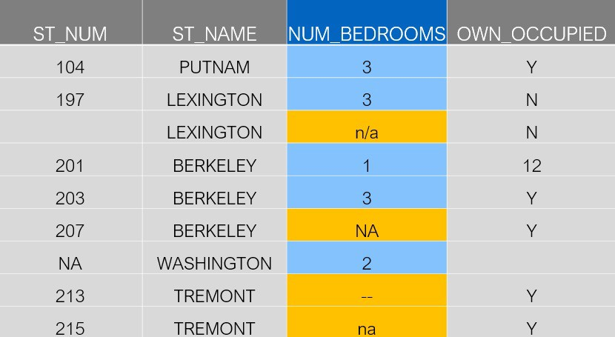
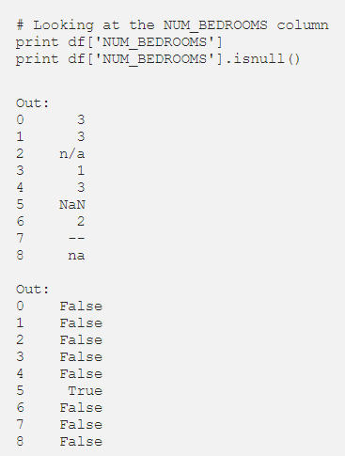
“Non-Standard” Missing Values
By default, Pandas recognized ‘NA’ as a missing value (and replaced it with NaN), but not the others. You’ll need to code these as missing yourself.

Slide 33
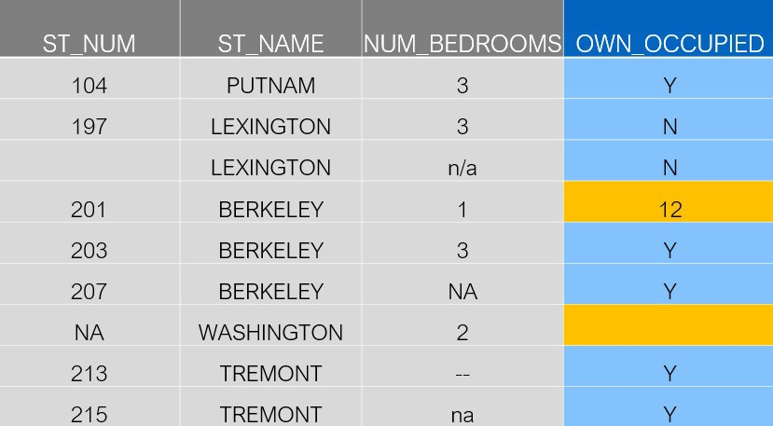
Unexpected Missing Values
Should familiarize yourself with your data before attempting to conduct any analysis to identify data issues.
Tools like the “Variable Explorer” in Spyder can help, especially for small datasets.
Summarizing each variable (using tools like the DataFrame describe(), count(), and value_counts() methods) will also help you to identify unexpected values in the data.
Other times, an observation may have nonsensical values – usually code these as missing as well.
Source: https://towardsdatascience.com/data-cleaning-with-python-and-pandas-detecting-missing-values-3e9c6ebcf78b

Slide 34
Outliers

Slide 35
Outliers
Outliers – extreme values that fall well outside of the norm for a given type of data. They can have a meaningful impact on estimates generated from the data.
How do you handle this?
Example: Examining a part of a hospital’s EHR data that was hand-entered during patient intake. You come across a female patient with a recorded height of 86 inches (7’2”)

Slide 36
Outliers
Outliers in data generally fall into one of two categories:
The outlier is an accurate representation of a rare phenomenon (e.g. this woman really is 7’2”)
The outlier was generated erroneously (e.g. meant to type “68 inches,” not “86 inches” in the patient’s EHR).
#1 then you might want to leave this observation in the data as-is.
#2, change the outlier to another value, or record it as missing?

Slide 37
Outliers
Outliers unduly skew your estimates? But contain information that you don’t want to do away, winsorizing a good approach
Example: estimating the mean lab test value from an imprecise blood test. Values are partially informative, but noisy.
Winsorizing: restrict the minimum and/or maximum values of numeric variable e.g., replace all values above the 99th percentile with the value corresponding to the 99th percentile.

Slide 38
Transparency
No single solution for cleaning “dirty” data.
Most important is to be transparent about the issue, and what you did to address it.
This enables others to appropriately interpret your analysis.
Document, document, document!

Slide 39
Questions?
Statistical brief overview
Dr Sarah Ashcroft-Jones | Mailman School of Public Health

